Slide 1
Project Name
BIODATA

Slide 2
Team Details
Team Name : Synapse
Github id : SYNAPSE04
E-mail id : synapse730@gmail.com
Slack id : Synapse
Reddit id : Synapse730
Stack Overflow : Synapse
Quora : SYNAPSE
Team Leader : Sahaya Jushma J (B.E)\
Team Members:
Reeba J (M.Sc, B.Ed)
Aswin S (B.B.A)
Ajay B (B.C.A)
Notes:
-Add team details with name and qualification,e-mail,phone no and place

Slide 3
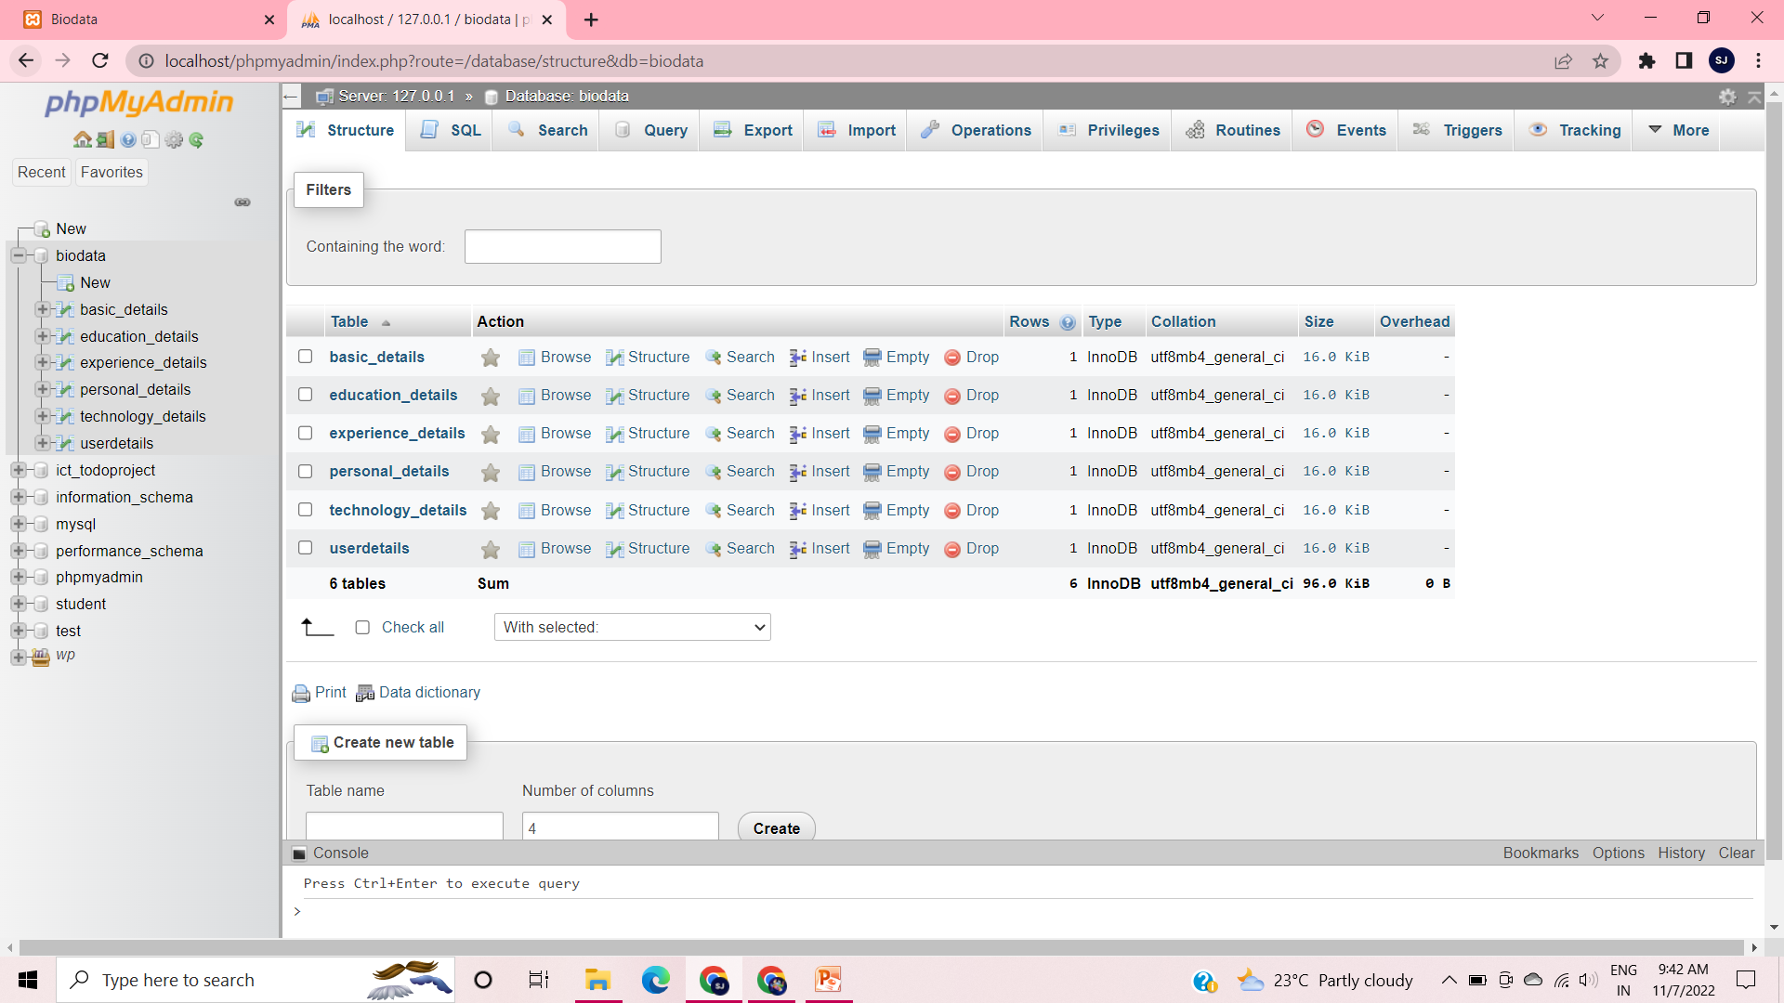
Database Design
Notes:
Get the database design from the phpmyadmin or from SRS document

Slide 4
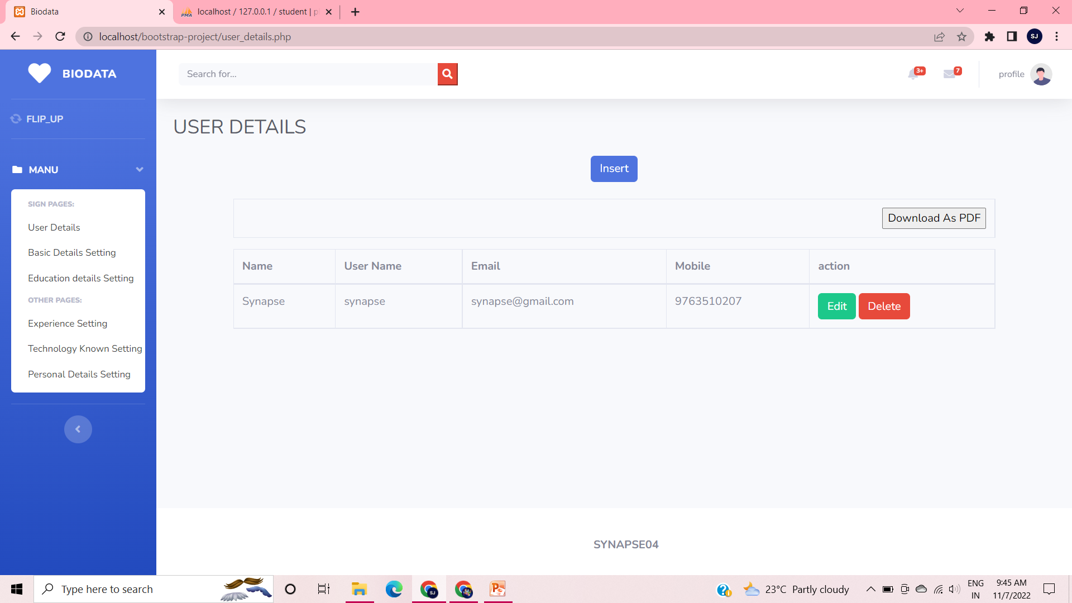
Form Design
Notes:
Get the form design from the phpmyadmin or from SRS document

Slide 5
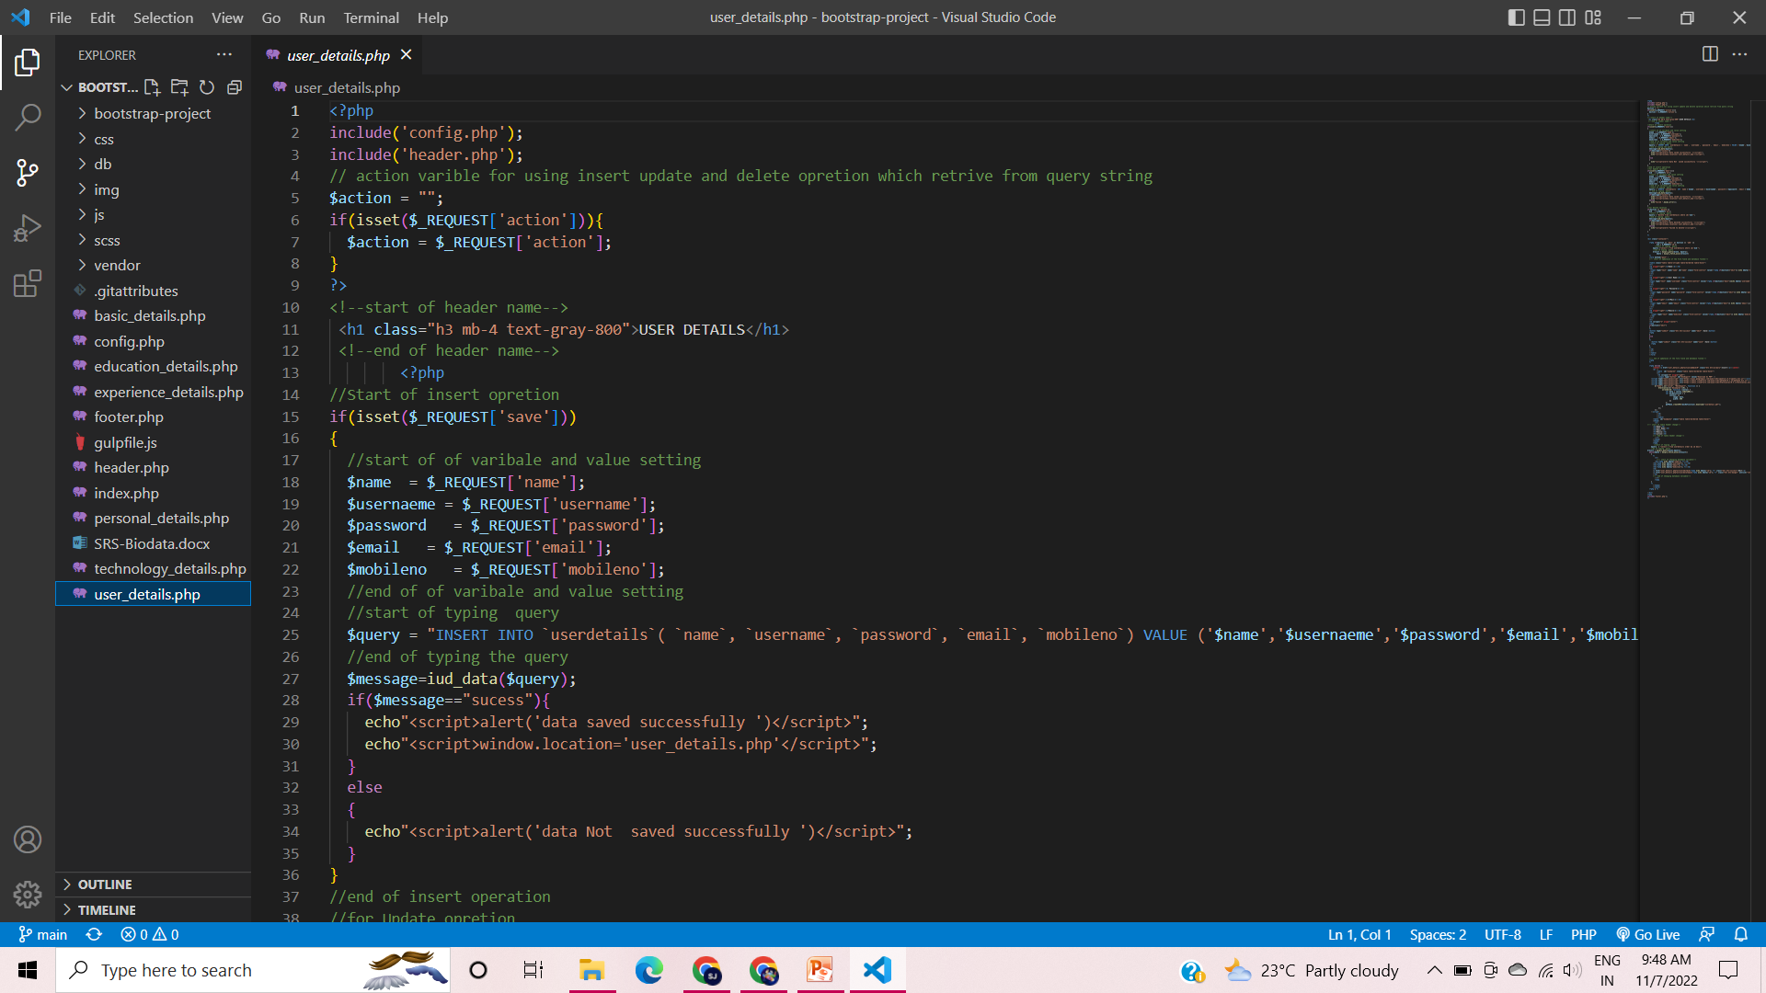
Sample Source code

Slide 6
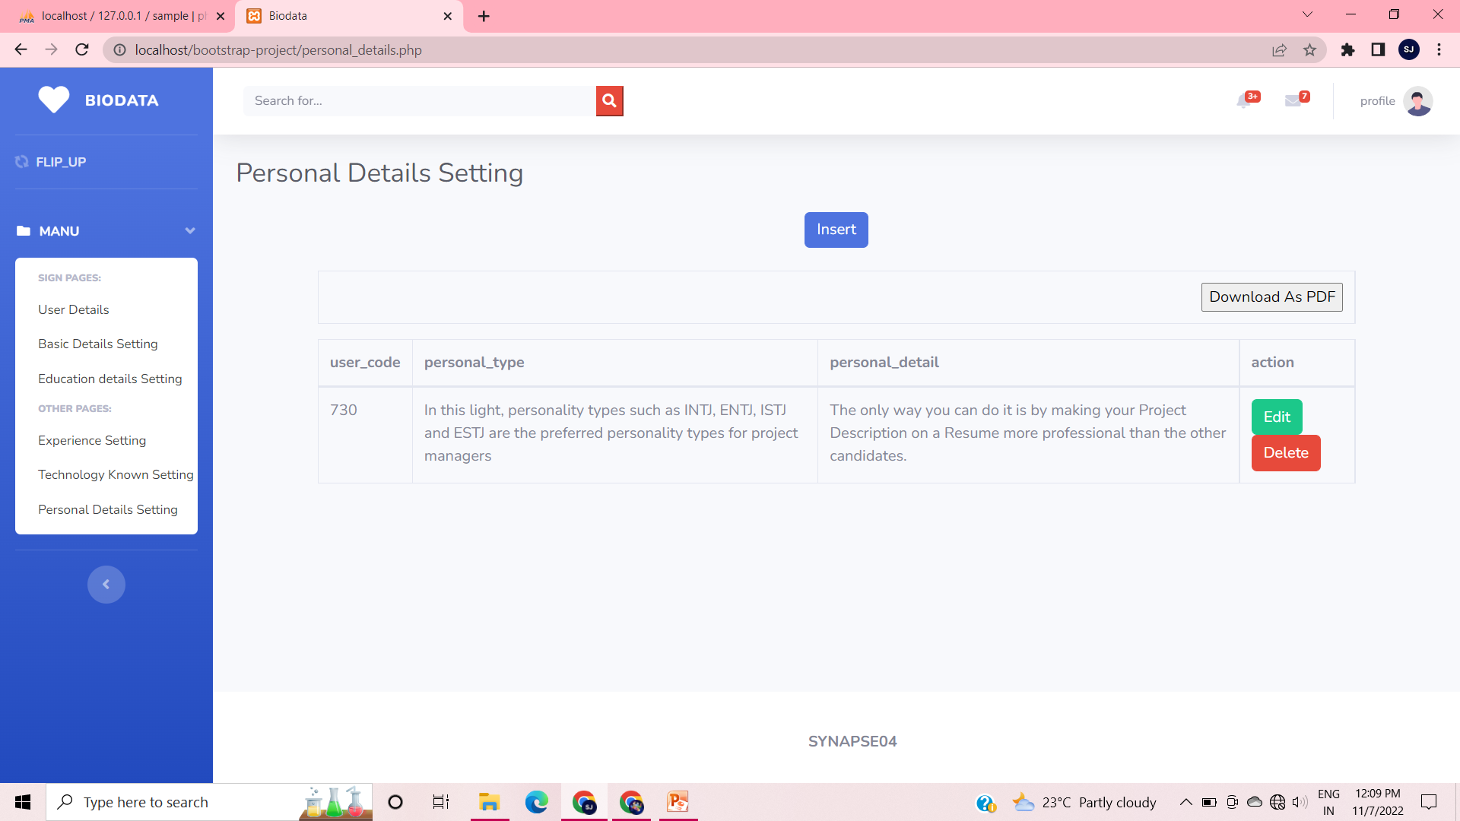
Form Design

Slide 7
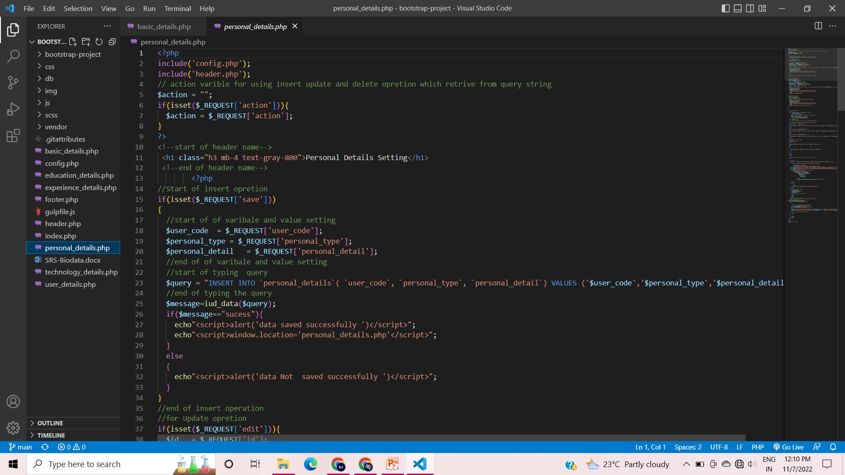
Sample Source code

Slide 8
TEAM LEADER Sahaya Jushma J

Slide 9
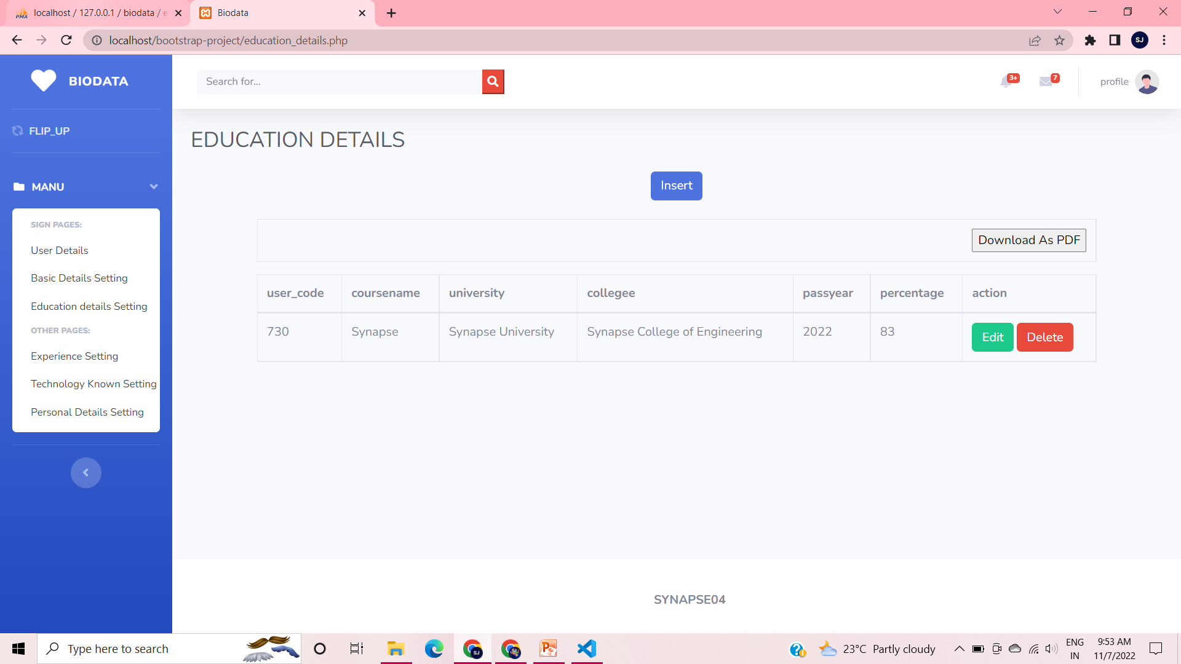
Forms & Database Design
Notes:
Explain Form and database worked with

Slide 10
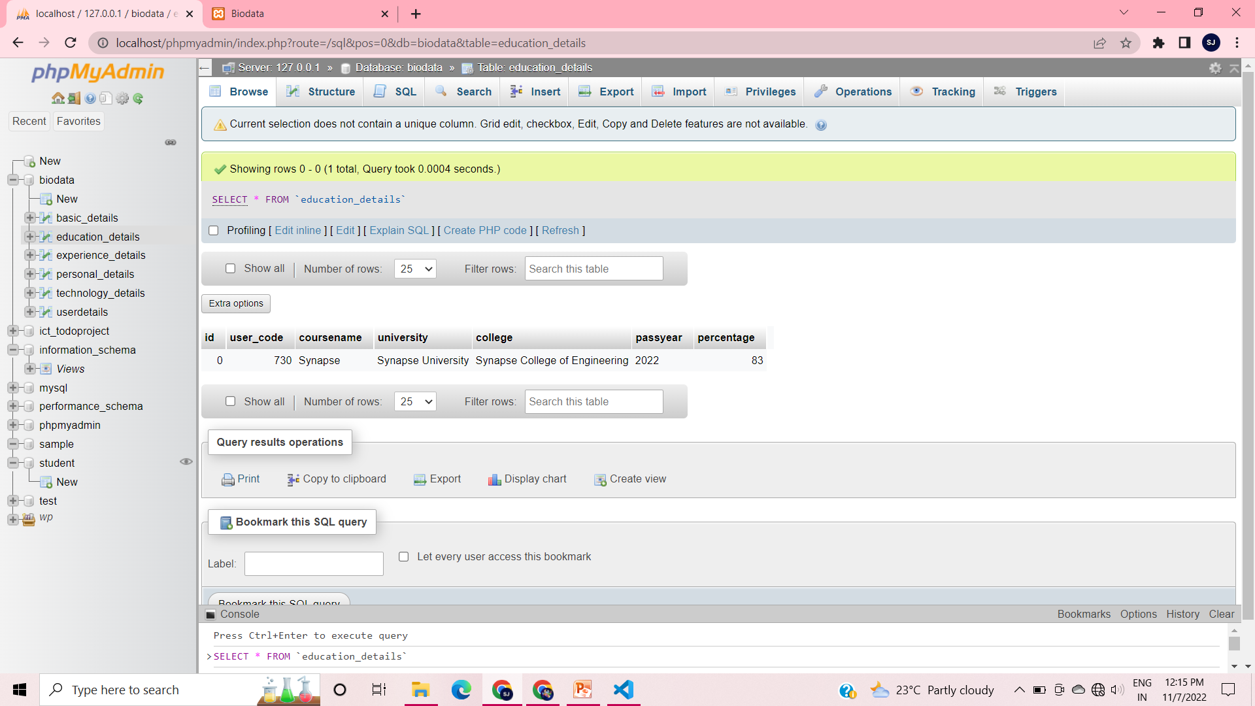

Slide 11
Problem/difficulty Faced
Faced many errors regarding queries.
The requested url was not found on server.
Faced some problems by neglecting the quotation and spaces.
Notes:
Explain problem faced

Slide 12
Solution to the problem
Solved the problem by correcting the queries.
Database is being updated.
Solved all the spaces and quotations.
Notes:
Explain how attained the solution

Slide 13
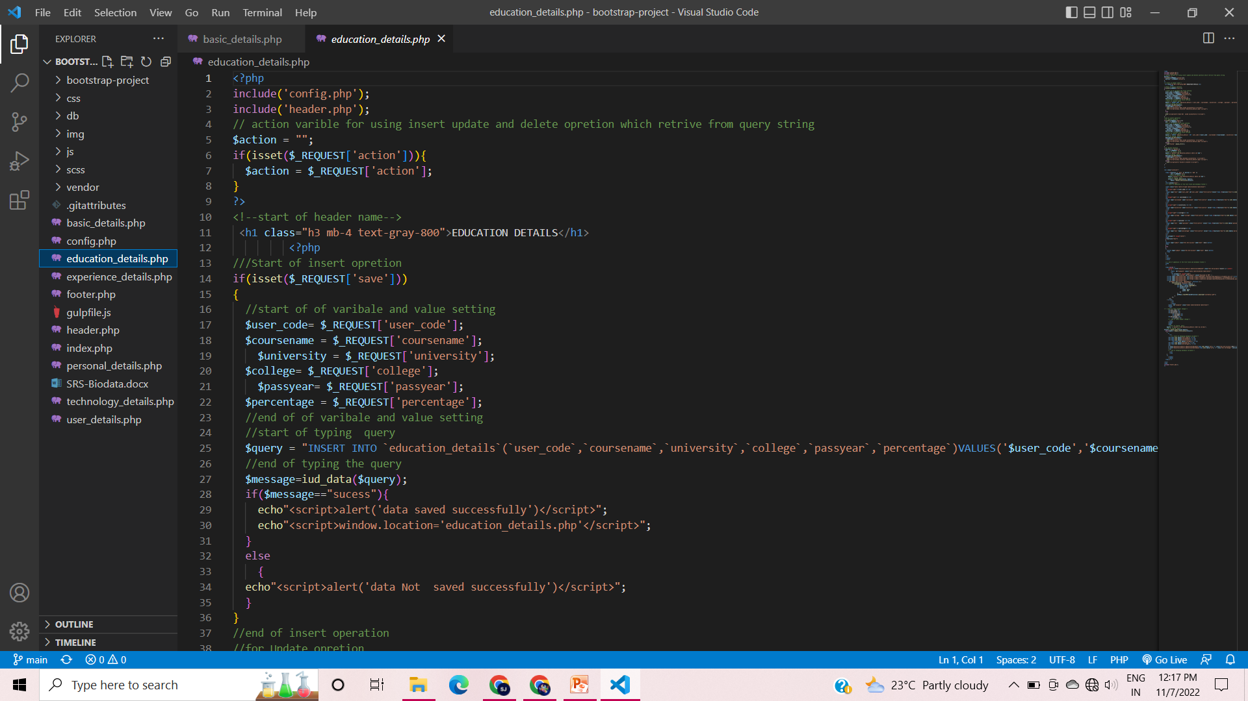
Sample Source code
Notes:
Explain how attained the solution

Slide 14
TEAM MEMBER -1 Ajay B

Slide 15
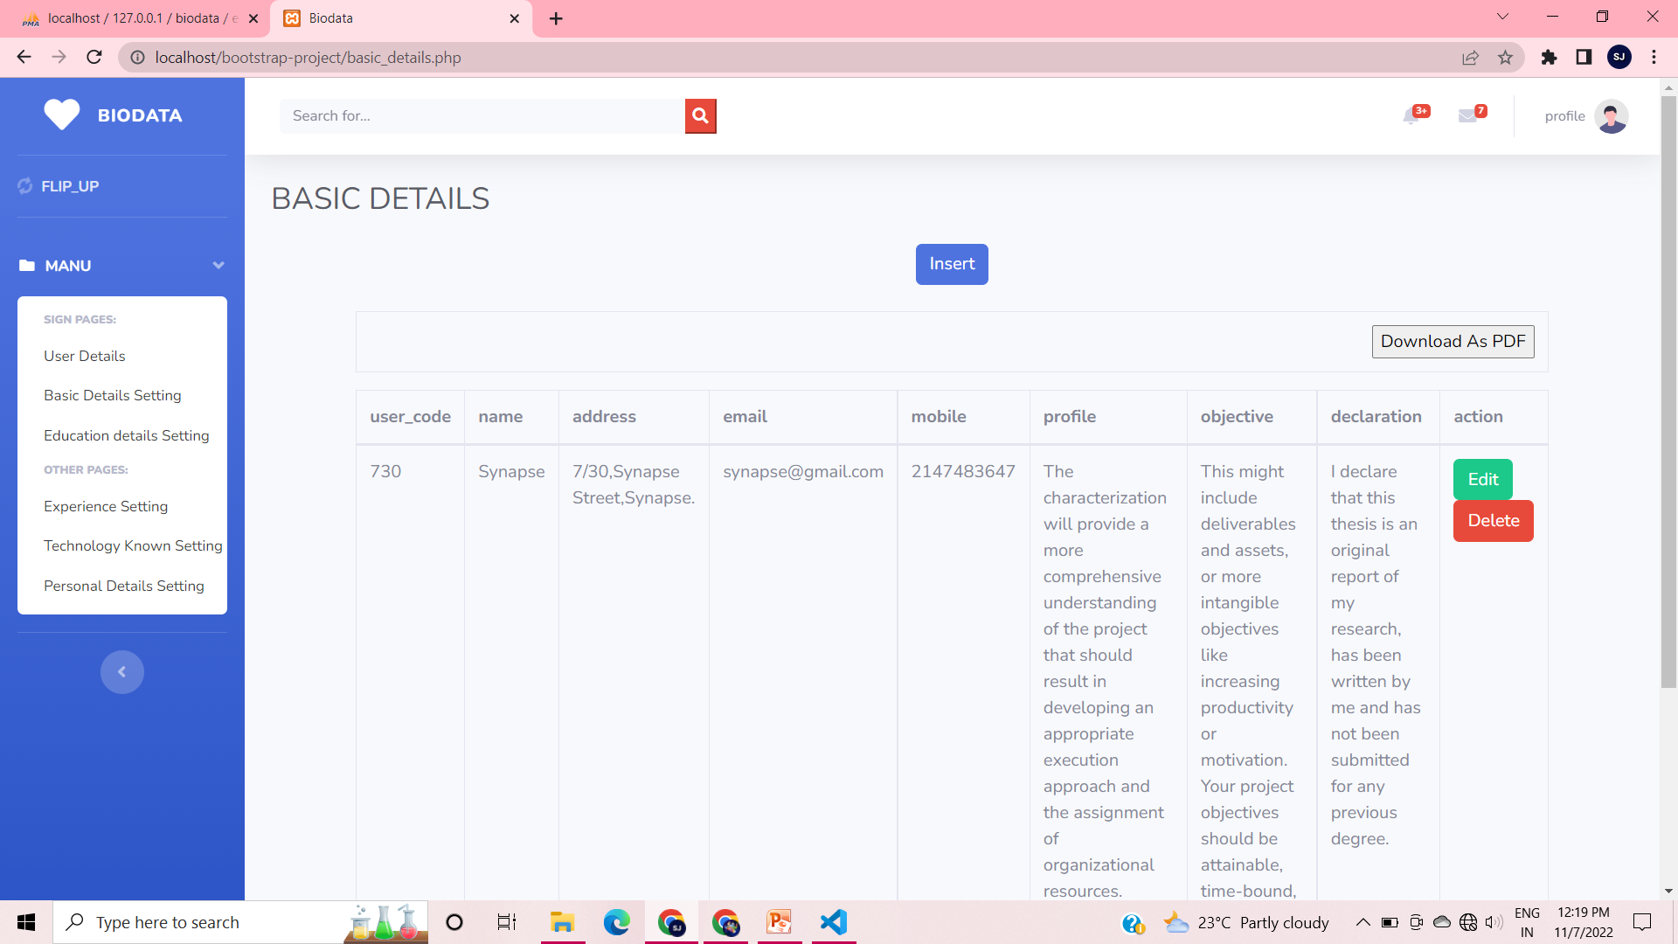
Forms & Database Design

Slide 16
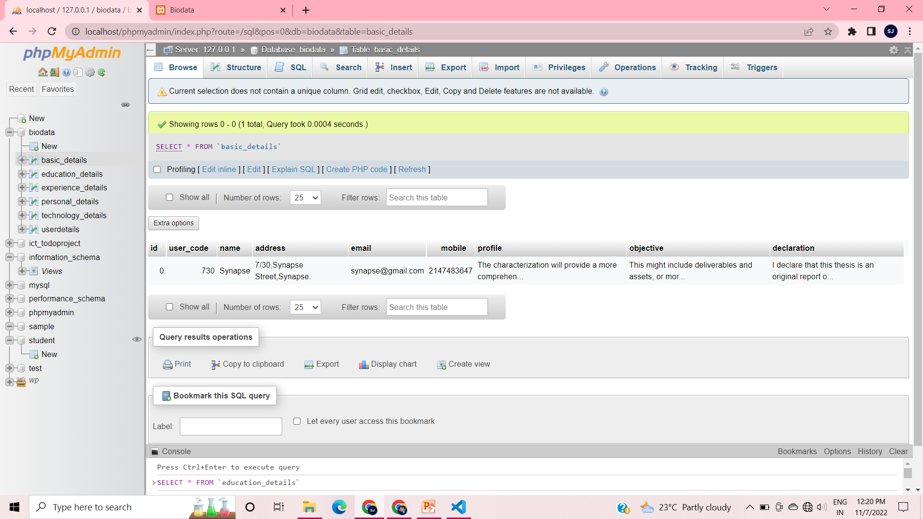

Slide 17
Problem/difficulty Faced

Slide 18
Solution to the problem

Slide 19
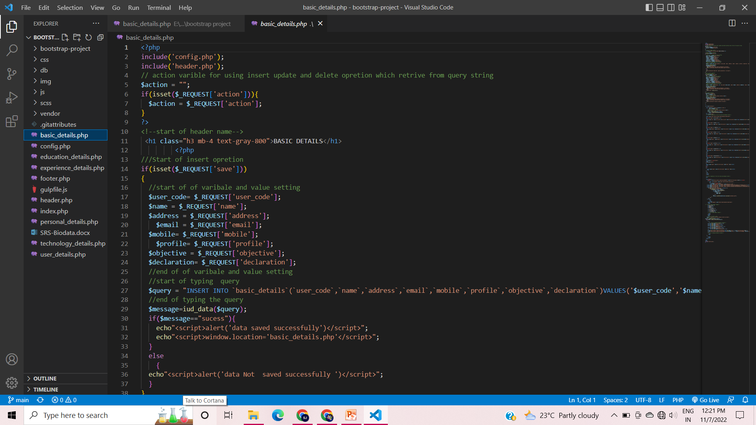
Sample Source code
Notes:
Explain how attained the solution

Slide 20
TEAM MEMBER -2 Reeba J

Slide 21

Forms & Database Design

Slide 22
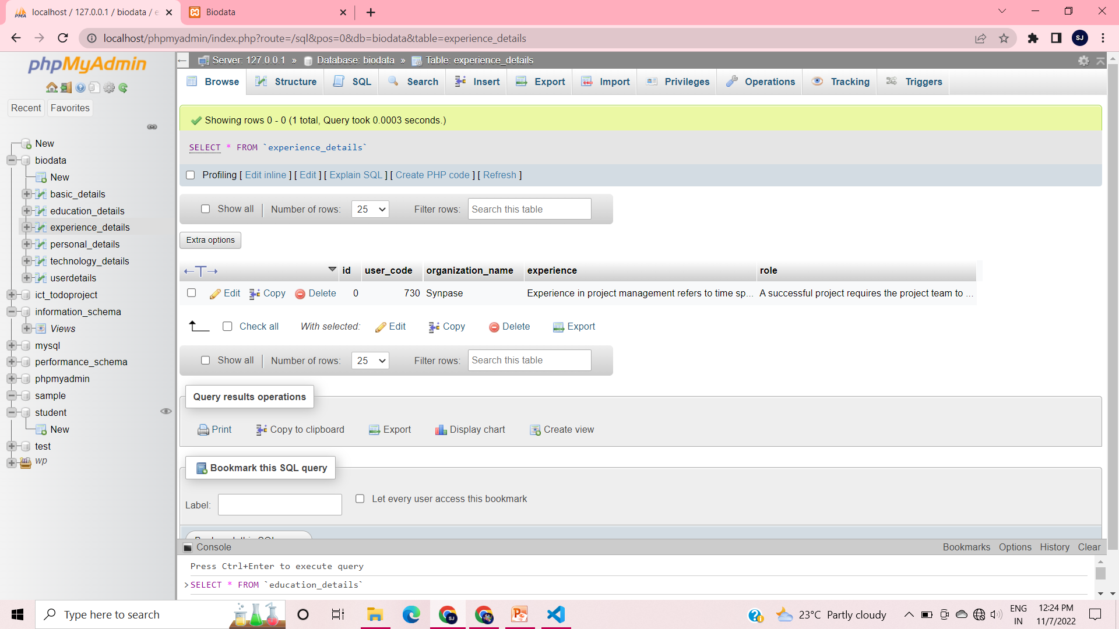

Slide 23
Problem/difficulty Faced

Slide 24
Solution to the problem

Slide 25
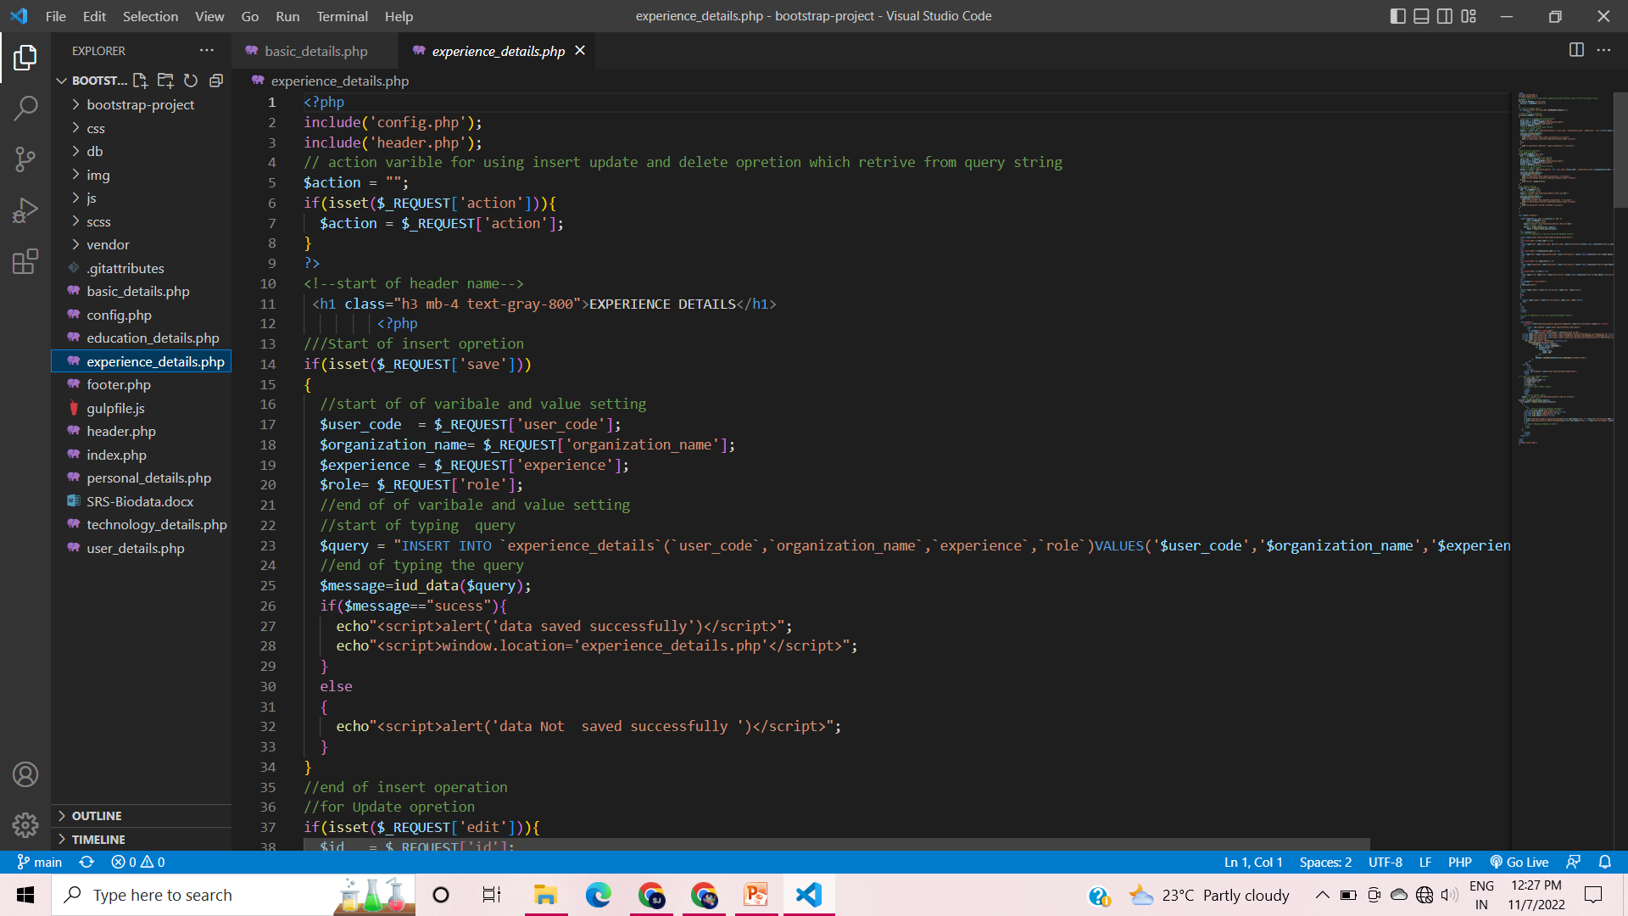
Sample Source code
Notes:
Explain how attained the solution

Slide 26
TEAM MEMBER -2 Aswin S

Slide 27

Forms & Database Design

Slide 28
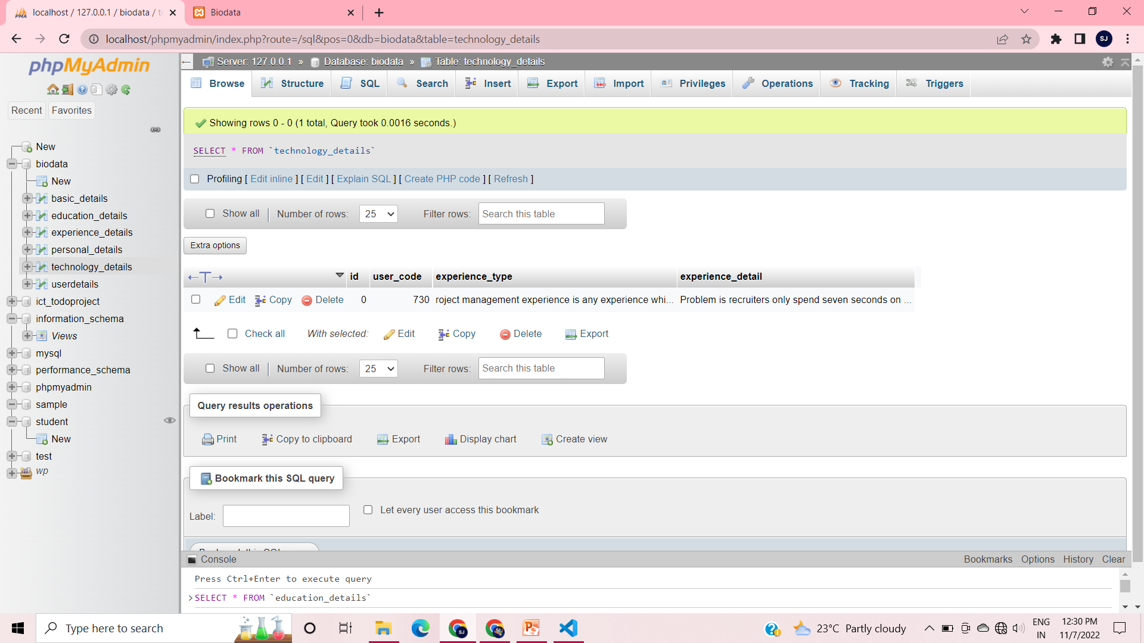

Slide 29
Problem/difficulty Faced

Slide 30
Solution to the problem

Slide 31
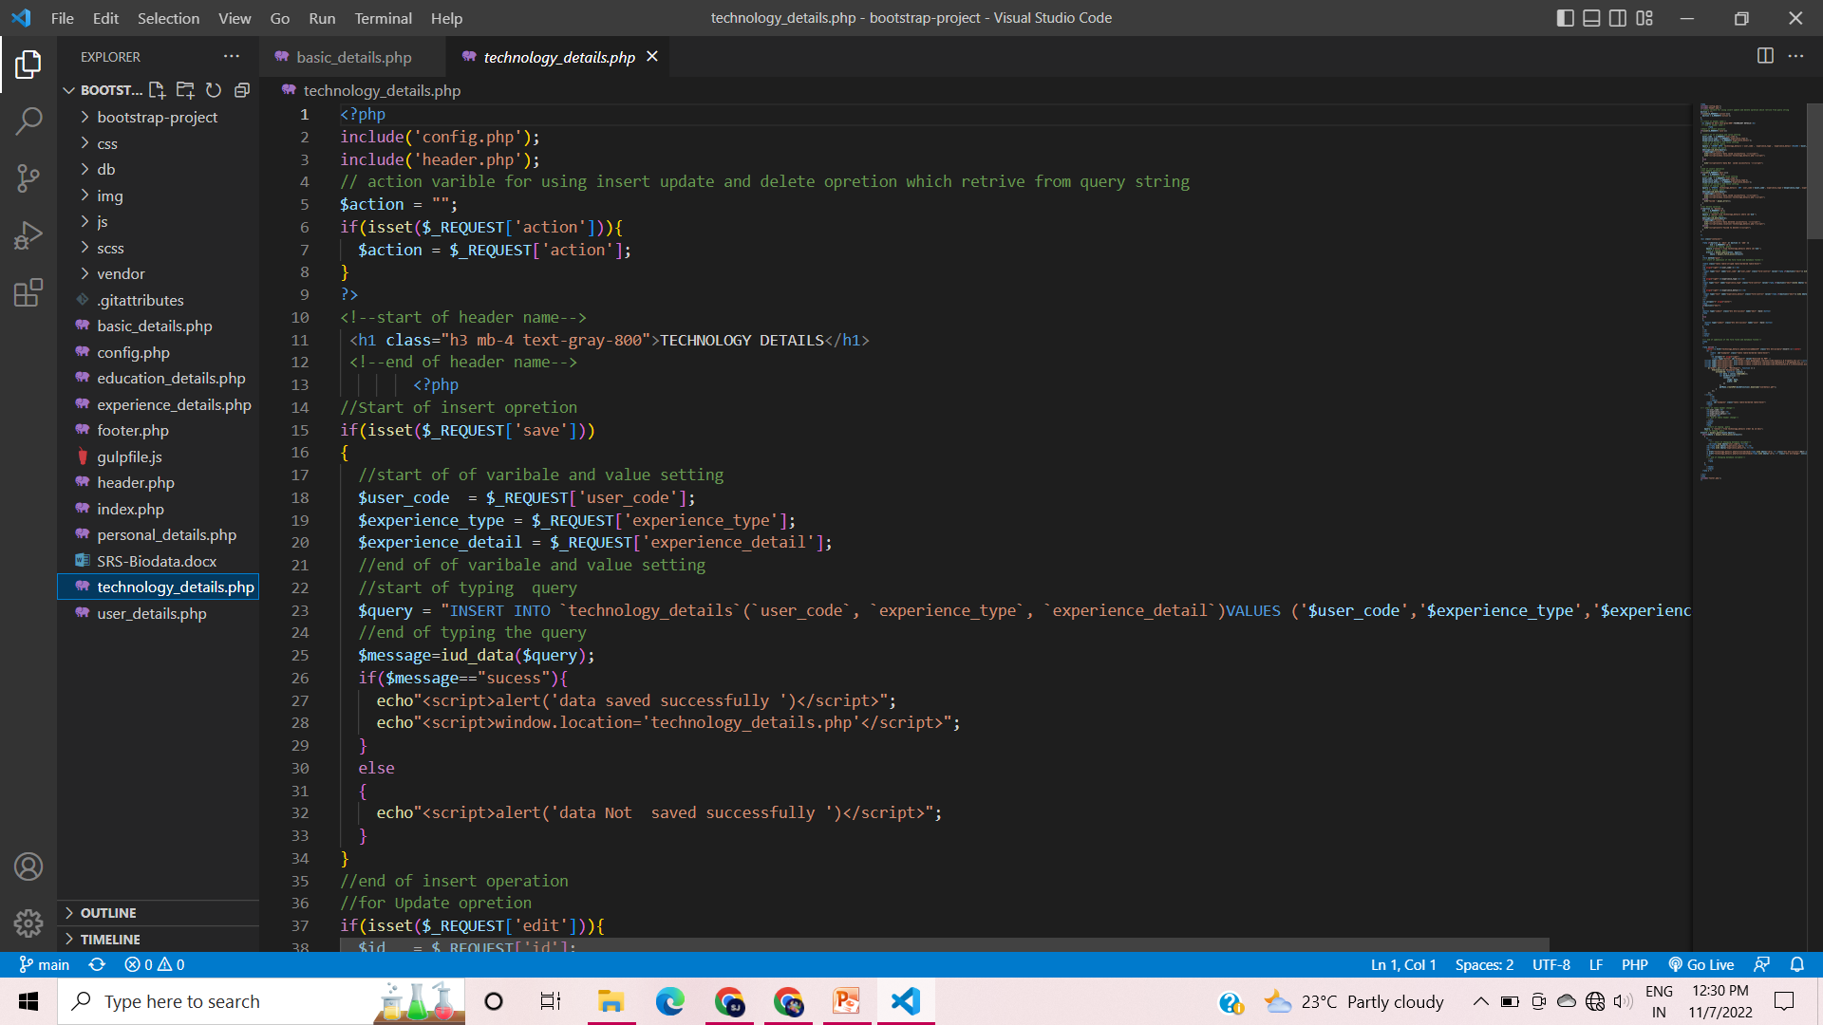
Sample Source code
Notes:
Explain how attained the solution

Slide 32
Thank You

